Slide 1

Analyzing the Top Hits
Spotipy
Featured Artist: The Janitors | Cam Foster, Anis Ali, Michael Alread, & Ida Astaneh
Release Date: 2020 – 10 – 27

Slide 2
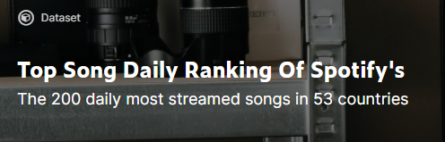


t h e o r i g i n a l d a t a
With over a million rows of data, The Janitors had their work cut out for them.
The original data set featured the top 200 streamed songs daily for 13 full months (starting on January 1, 2017) spanning across 17 countries around the world.
Given this information, our group started to wonder how we could effectively “clean” the data using the tools learned in class to come to meaningful conclusions.

Slide 3
q u e s t i o n s
Data Headers:
Position
Track Name
Artist
Streams
Date
Bins
Unique Track ID
Album
Release Date
Length
Popularity
Danceability
Acousticness
Energy
Instrumentalness
Liveness
Loudness
Speechiness
Tempo
Given the data provided, is there a direct correlation between our Spotipy headers?
Could we bucket the stream counts to show the percentage breakdown? How “popular” is popular?
Which artist/album appears the most and least amount of times on the list?
What decade was responsible for providing the most amount of streams?

Slide 4
h y p o t h e s i s
Before analyzing the data, our group collaborated to hypothesize the following:
If the rank of the Track Name is higher, does that mean that the stream count is larger?
If an artist appears on the list more frequently, does that mean the stream count is larger?
If the release of the track is newer, does that mean the stream count is larger?
If the artist has multiples albums on the list, does that mean the stream count is larger?

Slide 5

c l e a n i n g t h e d a t a
Given the sheer volume of information provided, we knew we wanted to “clean” as much as possible to give ourselves a small subset of the data.
Using the tools from class, our base data has a combination of the Spotify API to bring in additional columns, US data in 2017, and the trimmed version to exclude erroneous Track Names and Artists.

Slide 6
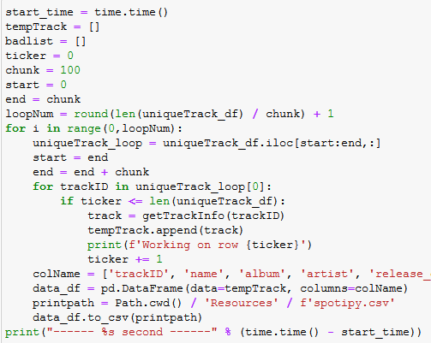
s p o t i f y A P I
Use the python library spotipy to interact with the Spotify API
Steps
Load US data in 2017 and found unique tracks
Created a loop to call the spotipy API for all tracks
Output the data and merged on Track ID with US data in 2017
Spotipy.audio_features()
Danceability | Describes hour suitable a track is for dancing (0-1)
Acousticness | A measure from 0-1 of whether the track is acoustic
Energy | A measure from 0-1 and represents a perceptual measure of intensity and activity
Instrumentalness | Predicts whether a track contains no vocals. 0-1, with 1 having a greater likelihood of no vocal content
Liveness | Detects the present of an audience in the recording
Loudness | The overall loudness of a track in decibels
Speechiness | Speechiness detects the presence of spoken words in a track. 0-1, with closer to 1 representing more exclusively speech-like recording (i.e. talk show, audio book, poetry)
Tempo | The overall estimated tempo of a track in beats per minute
Spotipy.Track()
Name | Track Name
Album | Album the Track appears on
Artist | Artist
Release Date | Release date of the Track Name
Length | Length of the Track in milliseconds
Popularity | Popularity (0-100)

Slide 7
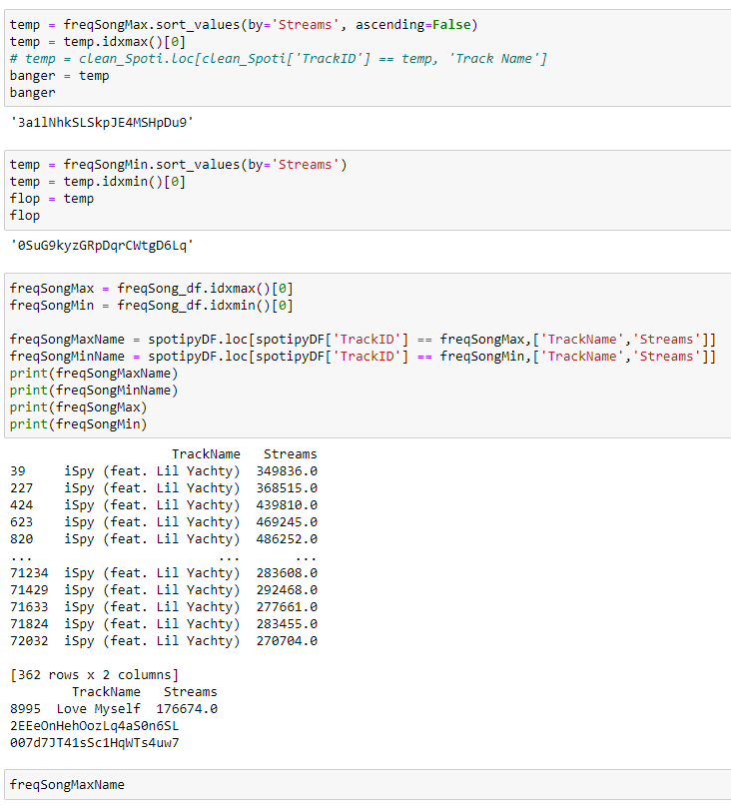
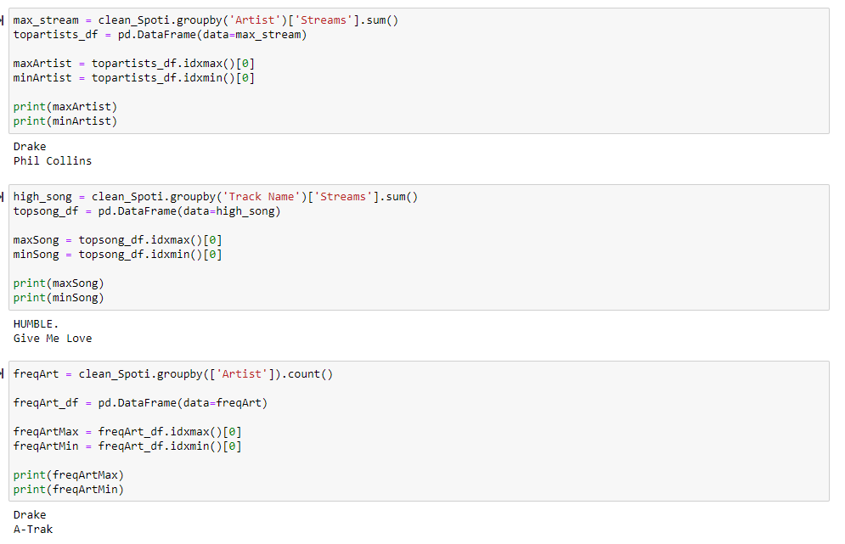
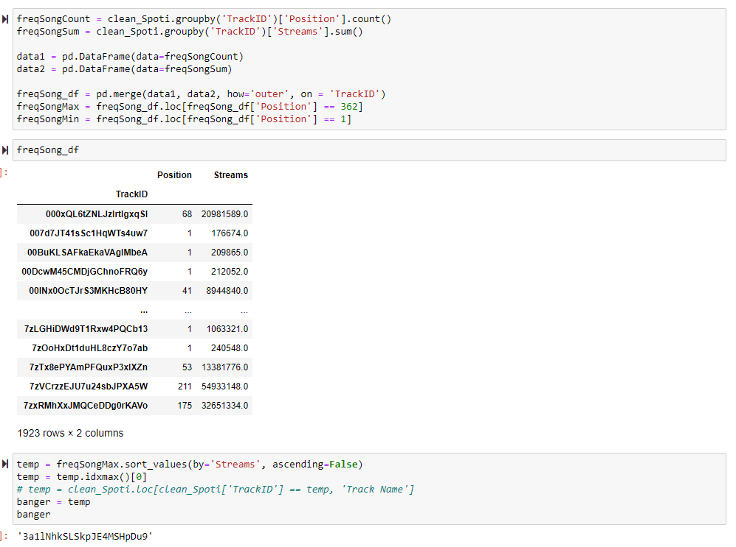
c l e a n i n g t h e d a t a

Slide 8
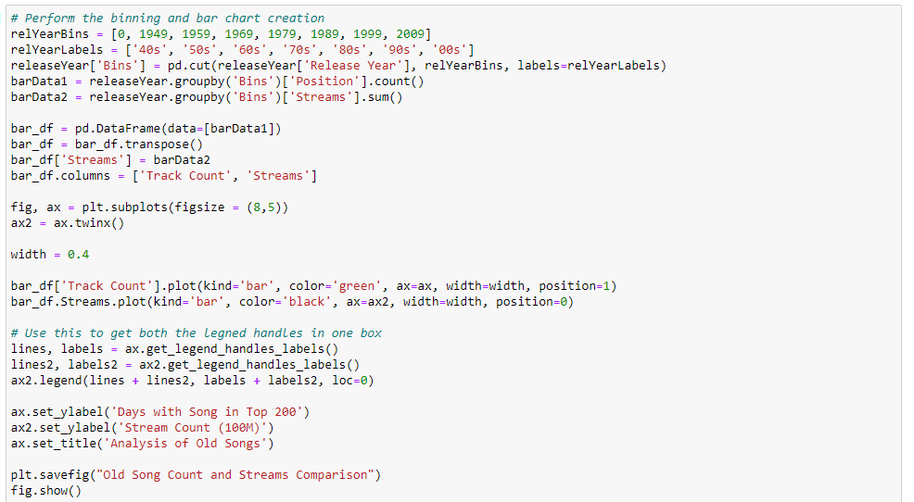
c o d e

Slide 9
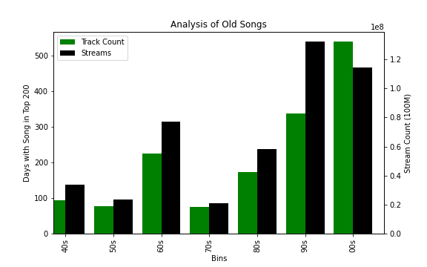
o u r g r a p h s
Analyzing Stream Count by Decades
Because our data was predominantly featuring songs from the 2000s, rows were filtered to eliminate bias and skewed information.
While the track count was the highest in 00s, The Janitors can see that the number of streams was larger across the board in all decades.
One can conclude that there is not necessarily a direct tie with stream to track count.

Slide 10
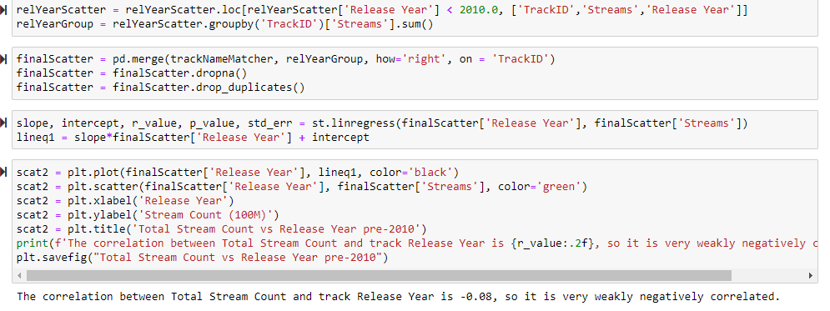
c o d e

Slide 11
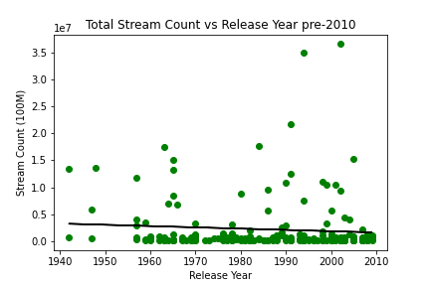
o u r g r a p h s
Stream Count by Release Year
Based off the data represented in the correlation map, The Janitors can conclude that there is a weak (to no) correlation tied between the stream count as the years progress.
In contrast to our previous graph, there are several outliers causing our data points to skew.
Theoretically, one would conclude that with modern technology and booming streaming industry, the stream counts would directly tie as the years progress.

Slide 12
c o d e

Slide 13
o u r g r a p h s

Slide 14
c o d e
ldsjfkdsfks

Slide 15
o u r g r a p h s
ldsjfkdsfks

Slide 16
c o d e

Slide 17
o u r g r a p h s

Slide 18
c o n c l u s i o n
Based off the data provided, The Janitors are can conclude that:
Number of streams has a direct correlation to the position rank
Artist frequency on the list equates to higher streams
As the years progress, the number of streams per artist will progress significantly
Just because an artist has multiple albums within the list, it does not mean that their overall stream count will be higher.

Slide 19

s o n g o v e r . q u e s t i o n s ?

